Slide 1
Usability Testing
COMP 6620
User Interface Design
Dr. Seals

Slide 2
What is usability?
Usability means focusing on users
People use products to be productive
Users are busy people trying to accomplish tasks
Users decide when a product is easy to use

Slide 3
Why Usability Testing?
To ensure that the product is usable for your user
Usability testing should be an iterative practice
Completed several times during the design and development life-cycle
End result is an improved product and a better understanding of the users that we’re designing for (Kaufmann 2006)

Slide 4
Usability Testing Components
Pilot Test
Usability Test

Slide 5
Usability Testing Components
Pilot testing
  Designed to identify hidden issues and eliminate surprises.
  Pilot testing tests the methods of your actual study as a trial
  Not with actual users
  During pilot testing you can make modifications to your final study

Slide 6
Usability Testing Components
Usability testing (Dumas & Reddish)
  Goal to improve usability of a product
  Participants represent real users
  Participants do real tasks
  You observe and record what participants do and day
  You analyze the data, diagnose the real problems, and recommend changes to fix those problems

Slide 7
What do I need to perform a Usability Test?
Approval from Institutional Review Board (IRB office on your university campus)
Usability Testing Protocol, Instruments, Prototype system
  Perform Pilot to validate Protocol & Instruments
  Perform Usability test
    Collect background demographics about users (Pretest questionnaire)
    Task List to guide user through usability test
    Collect data about test or user acceptance (Post test questionnaire)
    Analyze test
    Write testing results

Slide 8
What do I need to perform a Usability Test?
Approval from Institutional Review Board (IRB office on your university campus)
When you perform any experiment that involves human subjects you must receive consent from the Auburn Institutional Review Board if we plan to use the data collected in a publication. Just to make sure you are aware of any concerns that your study may impose on participants

Slide 9
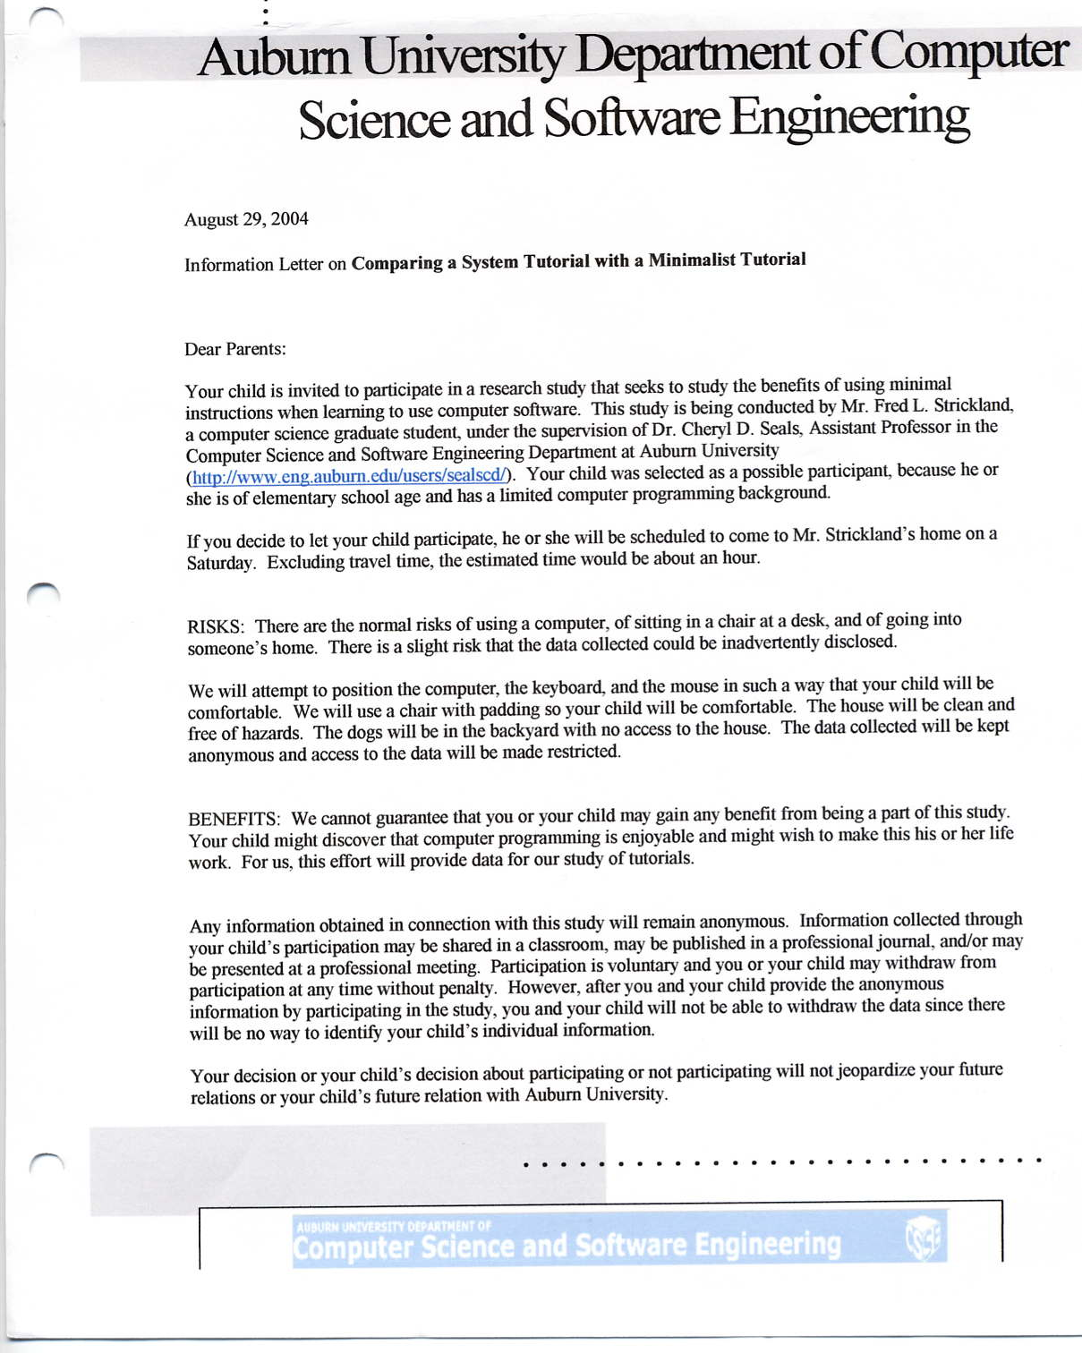
Information Sheet given to users

Slide 10
Pretest Questionnaire
To Obtain user demographics so that you are able to out biases in experiment that may be caused by age or experience

Slide 11
Task List
Contains multiple tasks or items (for our purposes 6, 12 or 18 tasks) that the user has to find or perform.

Slide 12
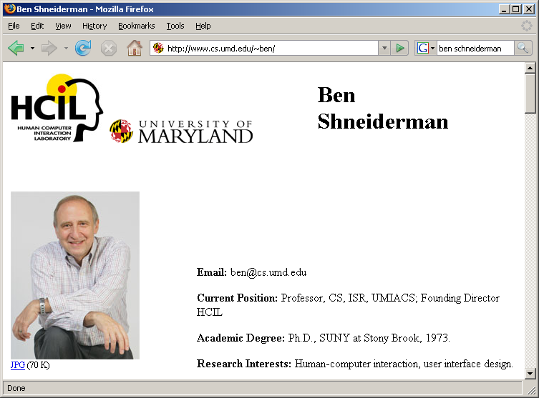


Post test Questionnaire
Ben Shneiderman, Design the User Interface

